Slide 1
Kickstarter
Predicting campaign success on
Natasha Borders
Notes:
Good morning, I’m Natasha and today we’re going to talk about Kickstarter and how to launch a successful campaign.

Slide 2
How does Kickstarter work?
All or nothing funding model
Creators want the campaign to succeed
Backers don’t want to miss a an amazing opportunity
Kickstarter profits from managing both sets of expectations
Notes:
Let’s begin by examining how Kickstarter works. The campaigns are based on all or nothing funding model, which means that if the campaign fails, no money changes hands. This means that the cost of failure is heavier on the creators who may have invested their time and money into a product only to see their efforts crushed. While it is also important for the backers to pick a successful campaign, and not miss out, I’m going to lean into the needs of the creators for the purposes of this analysis, to help Kickstarter attract more creators and grow the platform.

Slide 3
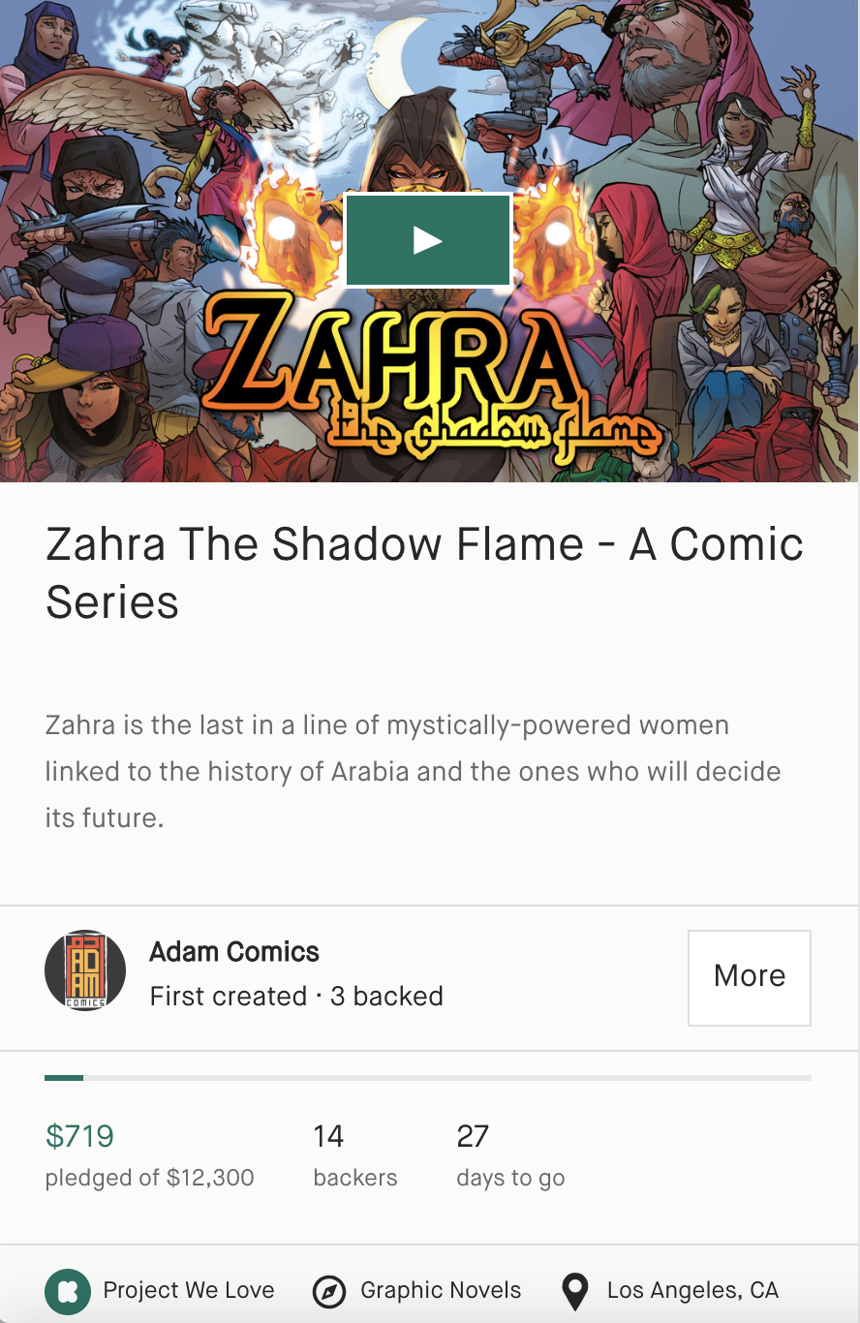
Campaign Data
Goal in USD
Campaign length in days
Category
Where the project is based
Marked as “Projects We Love”
Length of Description
Dataset obtained from a scraping website and compiled by aggregating monthly data covering April 2018-March 2019
Notes:
The data for this analysis came from a web scraping site which compiles Kickstarter data on an ongoing basis, and I examined the data covering April 2018 through March 2019, a year worth of failed and successful campaigns. The information used for prediction was the description of the campaign, set goal, endorsement from Kickstarter, category of the project, country, and the length of the campaign.

Slide 4
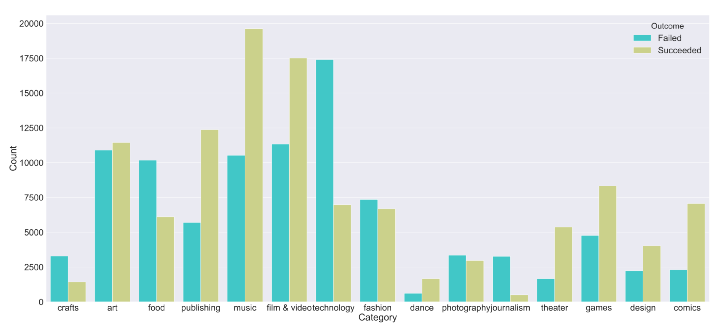
Kickstarter Campaigns
54% succeed, 46% fail
30 days – average campaign length
Notes:
Overall, Kickstarter campaigns span 15 categories ranging from art and crafts to technology, film and video. Slightly more than half of campaigns within my dataset were successful, so the classes were fairly well balanced. The average campaign length is around 30 days, and only a small percentage of project receive the official endorsement from Kickstarter.

Slide 5
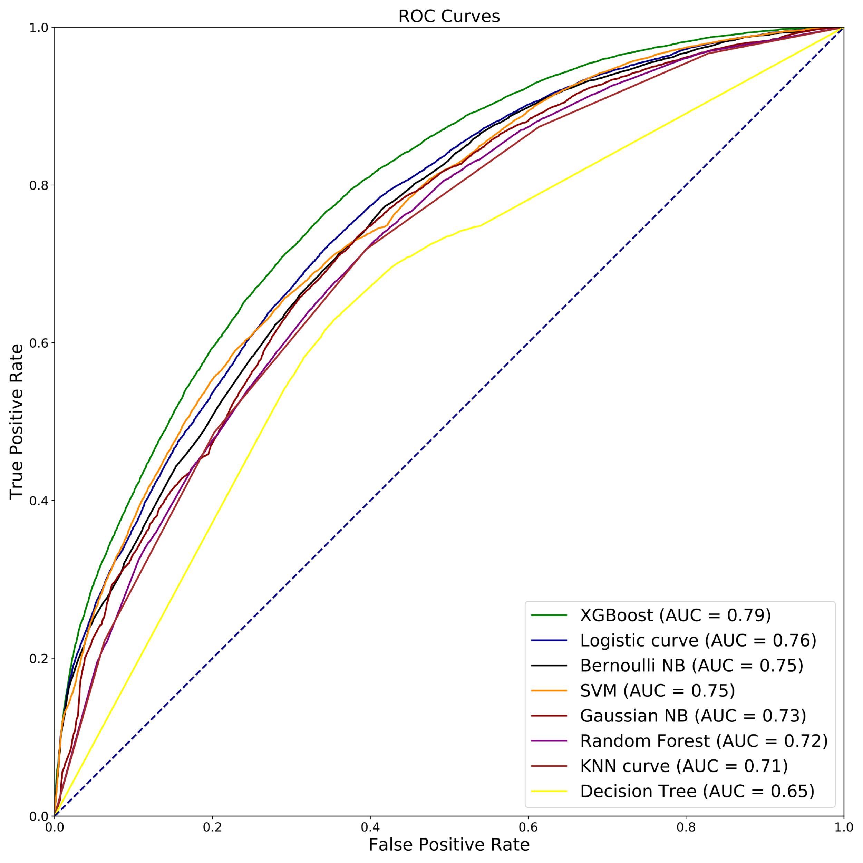
Model Evaluation
‘Success’ Class | Precision
XGBoost | .71
Logistic Regression | .69
Bernoulli NB | .68
SVM | .72
Gaussian NB | .64
Random Forest | .69
KNN | .68
Decision Tree | .67
XGBoost
(AUC = 0.79)
Notes:
These were the algorithms I considered, and based on the ROC curve performance, XGBoost and Logistic Regression were the top performers. Double checking the precision metric for the SUCCESS class of the campaign, the overall top performer is XGBoost. While SVM performed slightly better, its overall lower performance and excessive run times made it a less desirable candidate for production.

Slide 6
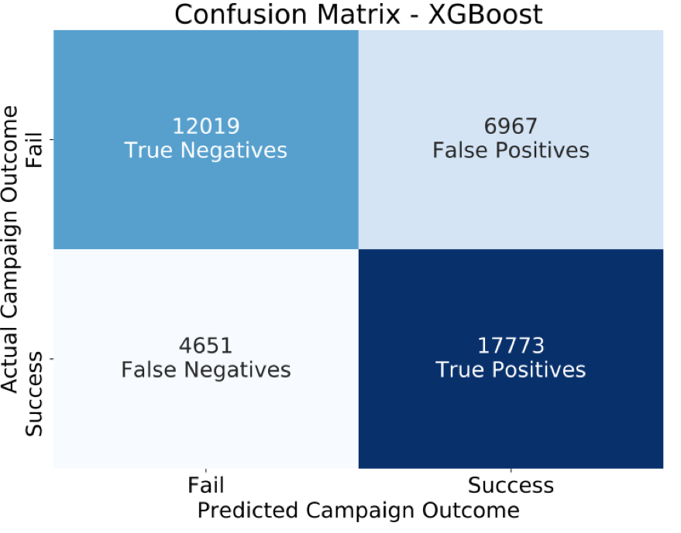
XGBoost Performance on Test Data
Train/Test Performance | XGBoost
AUC | .79/.79
Precision ‘Success’ Class | .71/.72
Notes:
After running the top performing model, XGBoost, on the test data, it performed similarly overall, and the precision score on the success class increased slightly. Overall, XGBoost performs well on both success and failure classes, and achieves high numbers of true positives and true negatives.

Slide 7
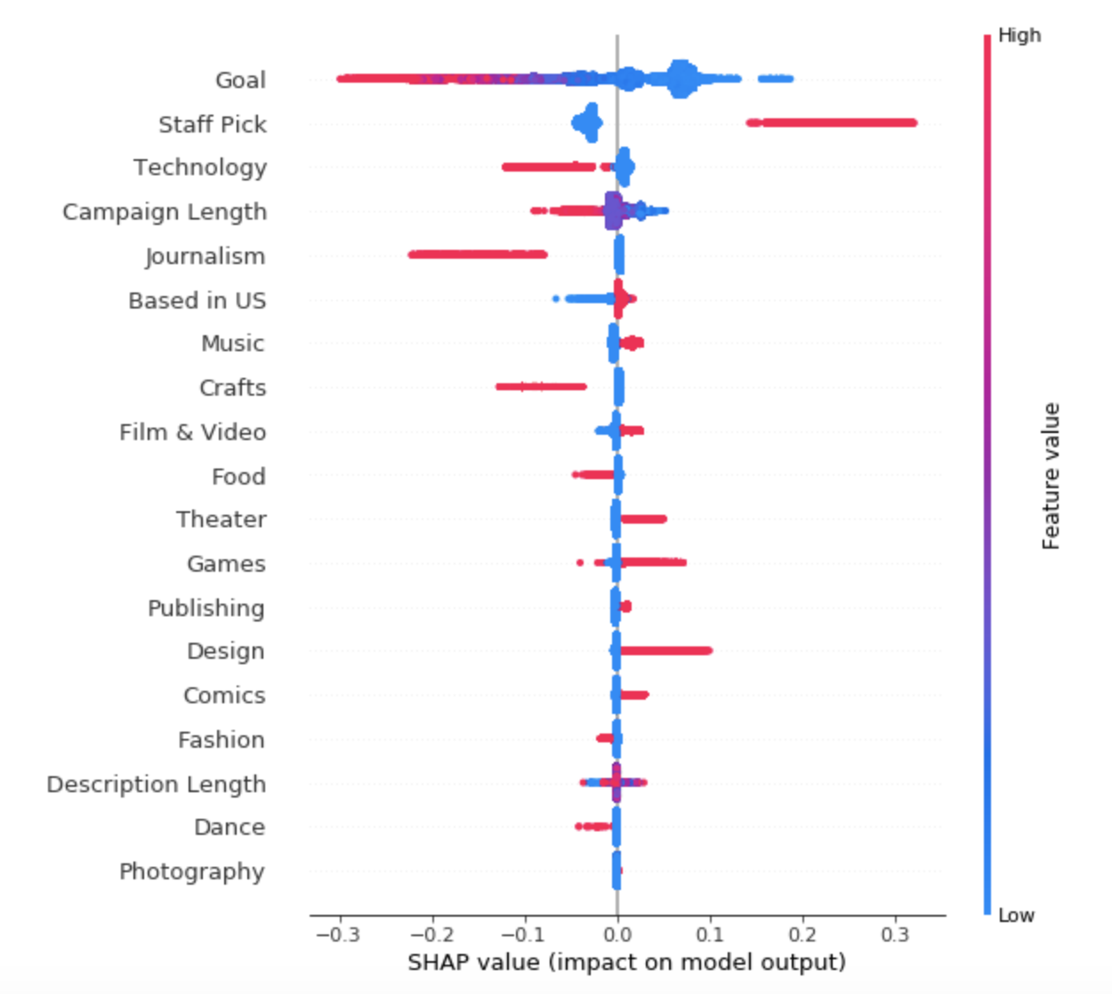
Feature Importance with XGBoost
Setting a low goal benefits the campaign
Shorter campaigns do better
Kickstarter endorsement improves chance of success
https://github.com/slundberg/shap
Notes:
Now let’s talk about what makes a successful campaign. Using a metric called the Shapley values, we can easily see what attributes have higher importance for campaign success. The color indicates the magnitude of the feature, low values are blue and high values are pink. The direction indicates positive or negative influence on the model outcome. The splotchy appearance comes from many data points clustered together at those points. The goal is an important consideration in a campaign. Having a small goal has positively affected many campaigns in small ways, and having large goals has been detrimental to a smaller proportion of campaigns. Having staff endorsement can go a long way, but not having it doesn’t hurt that much. The categories are being compared to art so we can conclude that design and games are getting higher traction than art while journalism and crafts appear to be negatively affecting the campaign’s odds of success.
In summary, Shapley values calculate the importance of a feature by comparing what a model predicts with and without the feature. However, since the order in which a model sees features can affect its predictions, this is done in every possible order, so that the features are fairly compared.
To get an overview of which features are most important for a model we can plot the SHAP values of every feature for every sample. The plot below sorts features by the sum of SHAP value magnitudes over all samples, and uses SHAP values to show the distribution of the impacts each feature has on the model output. The color represents the feature value (red high, blue low). This reveals for example that a high LSTAT (% lower status of the population) lowers the predicted home price.

Slide 8
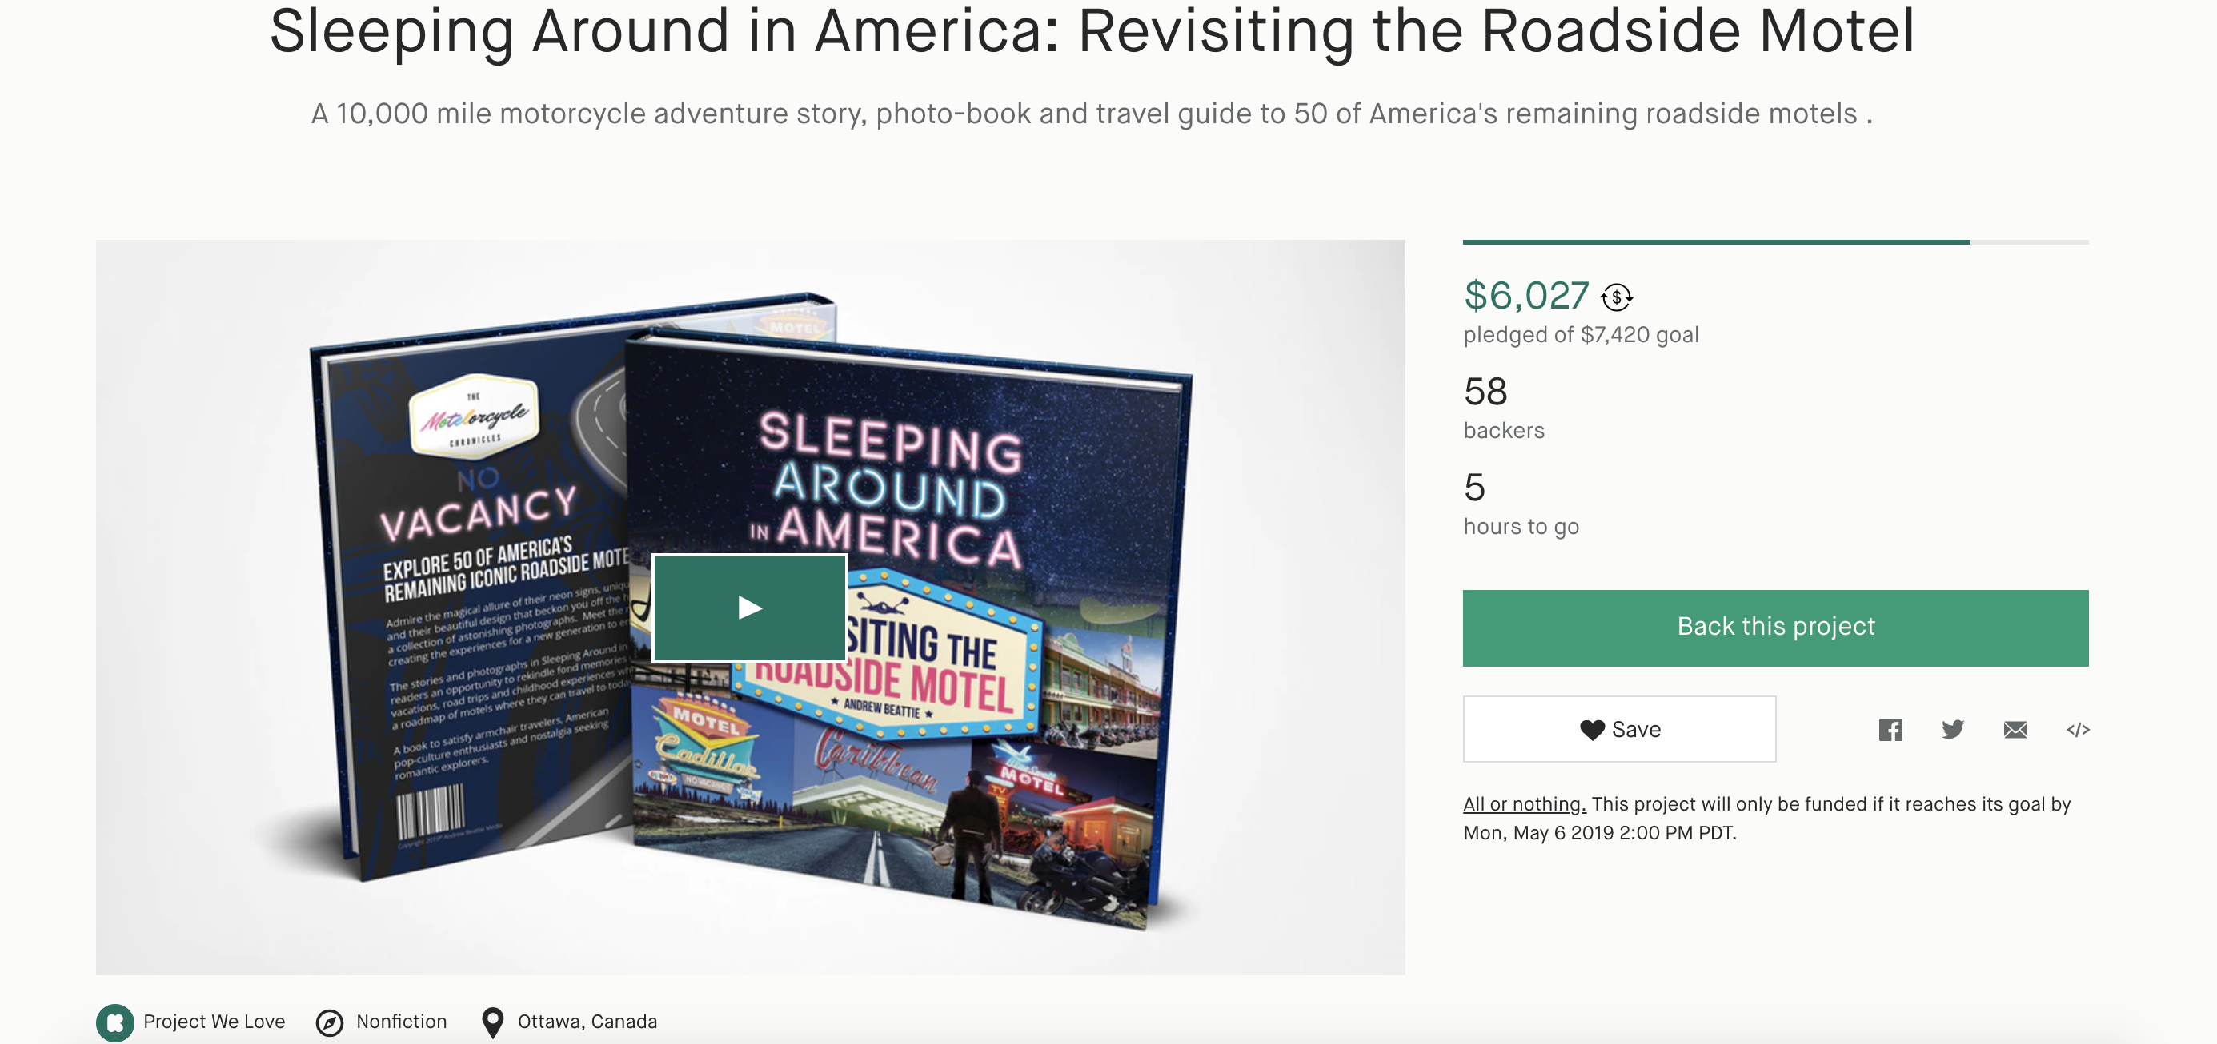

Slide 9
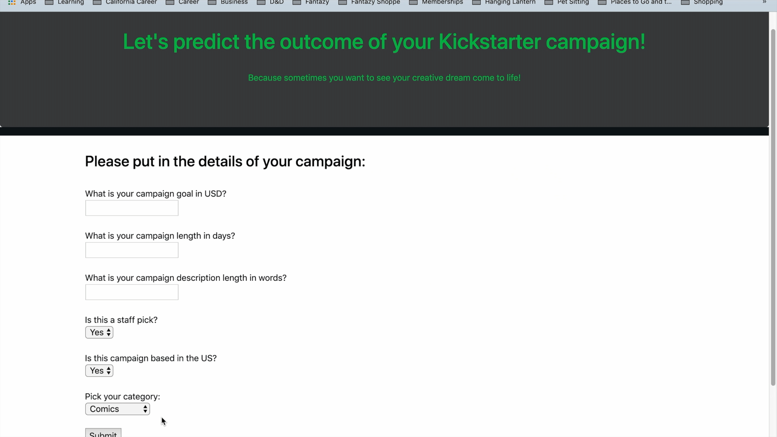
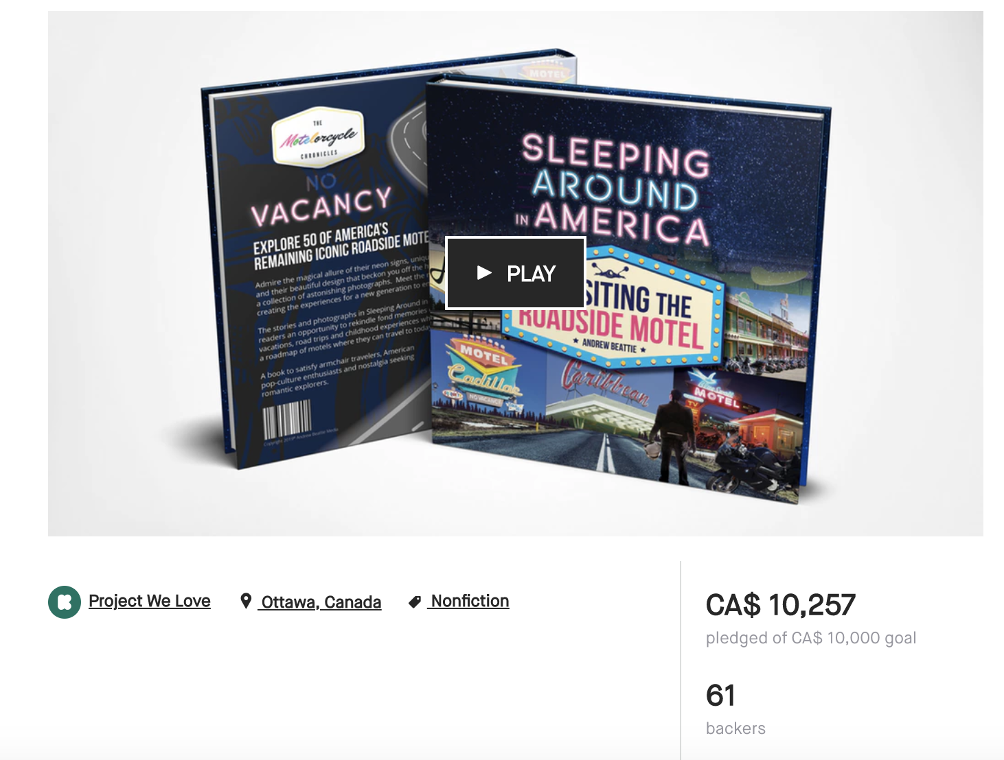
Notes:
To demonstrate this predictive algorithm at work, I developed a Flask app using the logistic regression model, second highest performing algorithm which proved to be easier and faster deployable than XGBoost. I chose a campaign that was ending in a few hours and predicted it’s outcome. Five hours later it ended in a success.

Slide 10
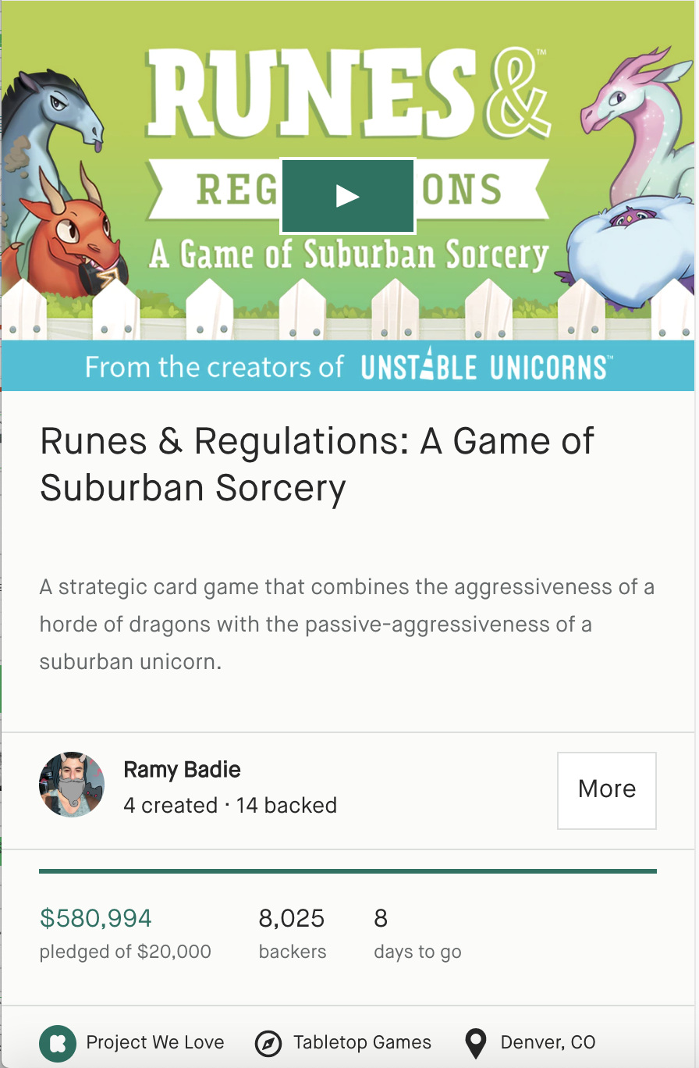
Creator Recommendations
Set a small goal in USD that fits the scope of the campaign
Don’t stretch the campaign past 30 days
Consider the category carefully
Get endorsed by Kickstarter
Notes:
Based on the findings, creators are recommended to set a low, achievable goal in USD which will satisfy their requirements, not stretch their campaign past 30 days, and to consider the category of their project carefully.

Slide 11
Next Steps
Develop XGBoost Heroku app
1
Explore monetary side of things
2
What will the future bring?
3
Full functionality and beautiful appearance
Do stretch goals help?
Explore how quickly campaigns are fulfilled
K
Notes:
Going forward, I’d like to develop an Xgboost Heroku app and increase the functionality and visual appeal, look into how much the successful campaigns raise and if setting stretch goals is beneficial, and dive into the ongoing challenge of campaign fulfillment and how it can be improved.

Slide 12
Thank you!
Any questions?

Slide 13
Analysis Pipeline
Data Cleaning
Feature Engineering
Grid Search CV
on
top performers
Flask app on
Heroku
Model Selection
AUC and Precision
Performance
evaluation
Notes:
I began by organizing the campaign data and extracting the features discussed in the previous slide. After analyzing the data using 8 different classification algorithms, I used the overall quality metric of an area under the curve, and then finetuned the top performing models by using the grid search. The top model was then evaluated on the test data. Finally I made a Flask app to demo the model.

